Slide 1
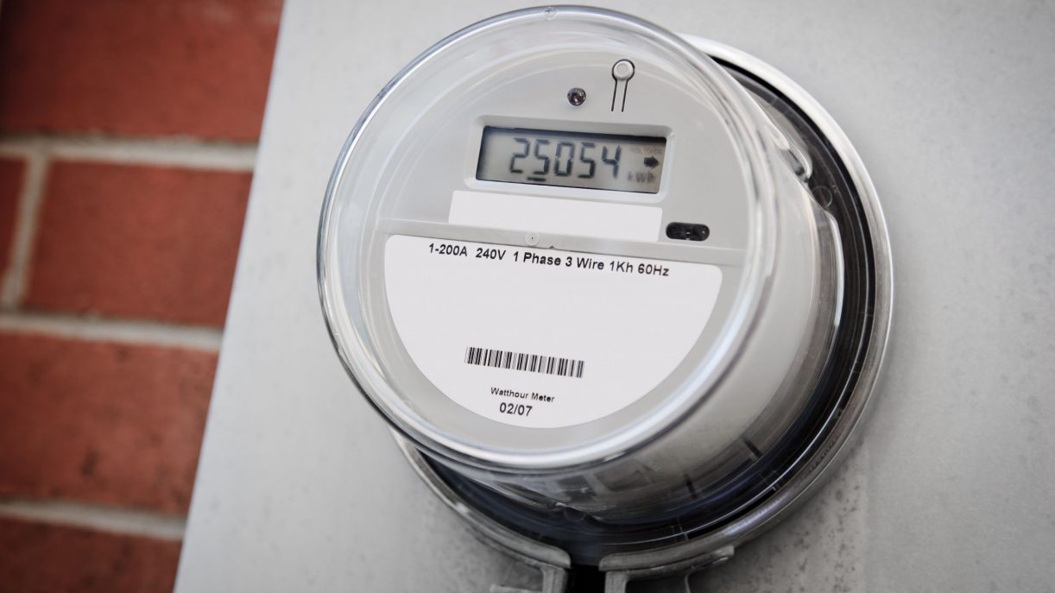

Time Series Forecasting for Energy Consumption Optimizing Resource Allocation in Smart Grid Systems
prepared by : under the guidance
Sreelakshmi m of entri elevate team
13/05/2024

Slide 2
CONTENTS
INTRODUCTION
PROBLEM STATEMENT
OBJECTIVES
ARCHITECTURE
IMPLEMENTATION DETAILS
RESULT
RESULT AND ANALYSIS
LIMITATIONS
CONCLUSION
FUTURE WORKS

Slide 3
Introduction
The demand for electrical energy has increased exponentially over the last many years. To improve the energy efficiency, consumers needs to be more aware of their energy consumption. This has increased the emphasis on the need for accurate and economic methods of energy consumption.
The objective of this project was to test if a machine learning model can yield good enough results in a complex forecasting problem, exploring machine learning techniques and developing a data-driven model for forecasting energy.

Slide 4
Problem Statement
This project aims to develop a time series forecasting model for predicting energy consumption patterns in smart grid systems. By leveraging historical data on energy usage, weather conditions, holidays, and other relevant factors, the model seeks to forecast future energy consumption accurately. The goal is to optimize energy distribution and resource allocation, enabling efficient management of electricity grids. By forecasting energy consumption patterns, this project contributes to reducing costs, improving grid reliability, and promoting sustainability in energy management.

Slide 5
Objectives
Development of an accurate time series forecasting model for energy consumption.
Optimization of energy distribution and resource allocation in smart grid systems.
Reduction in operational costs and improved grid reliability.
Enhanced sustainability through efficient energy management practices.
Evaluate the performance of different models in predicting energy consumption.
Evaluate the impact of different feature selection methods on the performance of predicting time series forecasting of energy consumption.

Slide 6
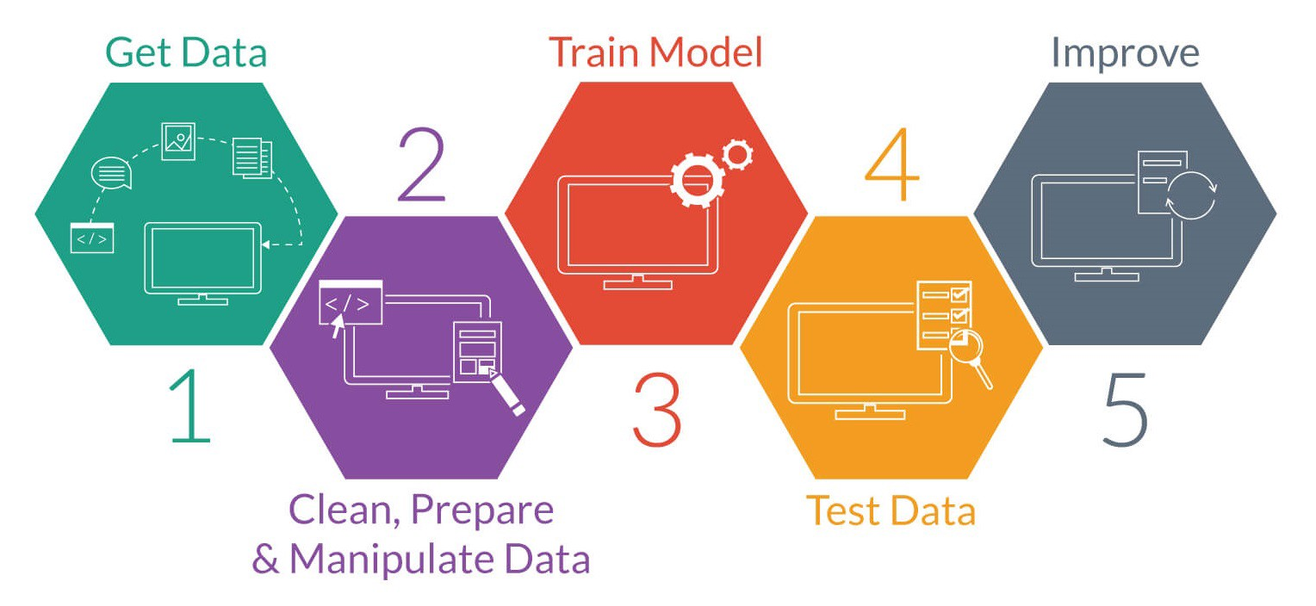
Architecture

Slide 7
Implementation Details

Slide 8
Data Collection and validation
The dataset was given by the ENTRI Elevate team.
The given data has 43825 rows and 15 columns.
Data type of columns – Validating the data type of the columns if wrong, then it was corrected.
Null values in columns – Validating the column in the dataset have null values or missing information.

Slide 9
2. Data-preprocessing
Preprocessing steps involve handling missing values, normalizing attributes and splitting the dataset into training, validation, and test sets.
Performing EDA to get insights of the data like identifying distribution, outliers etc.
Check any null values present in the dataset. If present then impute or remove those null values.
Checking for duplicate values.
Encode the categorical features/columns.
Removing unnecessary columns.
Perform several visualization tools like Boxplot, Scatter plot, Count plot and Histogram.
Checking the correlation between features and target variables using correlation matrix and heatmap.
Perform Standard Scalar to scale down values.

Slide 10
3. Model Selection
Choosing the appropriate machine learning model is crucial for the success of the predicting energy consumption patterns in smart grid systems. Considerations include the complexity of the data, the interpretability of the model, and computational efficiency. So models include linear regression, Random Forest regressor, Support Vector Regressor and multi-layer perceptron(MLP) regressor are used.

Slide 11
4. Feature selection
Using feature selection methods like Selectkbest, SelectFromModel with Lasso (L1 Regularization), Recursive Feature Elimination (RFE) with Random Forest Regressor and Variance Threshold.

Slide 12
5. Model training:
Split 80% of the dataset into training data (used for model training) and 20% into testing data (used for model evaluation).
During training, the model learns patterns and relationships in the training data to make predictions.

Slide 13
6. Model evaluation
Predictions: Use the trained model to make predictions on the test data (X_test).
Evaluation Metrics: Calculate performance metrics (Eg: mean absolute error(MAE), mean squared error(MSE) and r2 score) to assess how well the model generalizes to unseen data.

Slide 14
Result

Slide 15
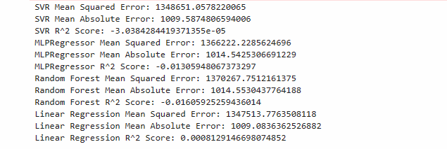
Without using feature selection

Slide 16
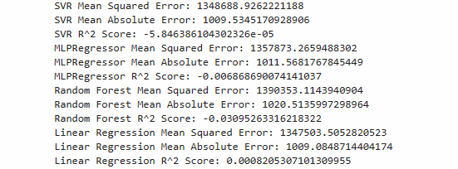
feature selection using
Selectkbest

Slide 17
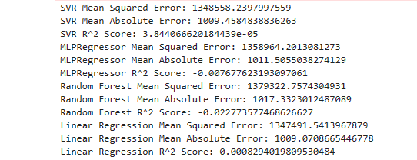
Feature selection using
SelectFromModel with Lasso (L1 Regularization)

Slide 18
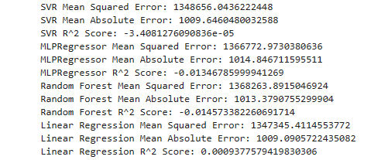
Feature selection using
Recursive Feature Elimination (RFE) with Random Forest Regressor

Slide 19
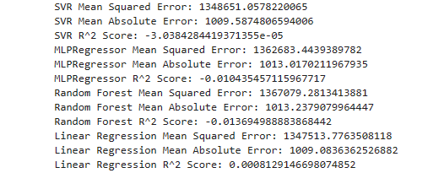
Feature selection using Variance Threshold

Slide 20
Result and Analysis:
Without using any feature selection methods or hyperparameter tuning linear regression gives the best r2 score (0.00081291). The other models give negative r2 score.
Among all these feature selection techniques, Recursive Feature Elimination (RFE) with Random Forest Regressor method performed well and gave Linear regression as the best model with an r2 score of 0.00093776.

Slide 21
Limitations:
Despite the absence of missing values and outliers, the low correlation between features and the target variable suggests that the selected features may not adequately capture the underlying patterns or predictive signals related to equipment failures or maintenance needs.
The low correlation between features indicates that the chosen features may not fully capture the complex relationships and interactions within the dataset. This limitation could hinder the models' ability to generalize well to unseen data or accurately predict future maintenance events.
Limited discriminatory power despite using multiple feature selection methods. Model accuracy may be influenced by complexity, hyperparameter sensitivity, or overfitting.
The dataset's limited scope or representation of industrial machinery and operational conditions may also contribute to the low accuracy of the models.
External factors and context not accounted for in the dataset may introduce uncertainty in model predictions.

Slide 22
Conclusion:
This project highlights the effectiveness of machine learning techniques for a time series forecasting model for predicting energy consumption patterns in smart grid systems . The examination of four machine learning models that are SVR, MLP Regressor, Random Forest Regressor and Linear Regression, for predicting machine failure shows that Linear Regression is the best performing model with an r2 score of 0.00093776.The feature selection method, Recursive Feature Elimination (RFE) with Random Forest Regressor, showcased promising results by identifying a subset of features conducive to linear regression modeling. These findings underscore the challenges posed by the dataset's limited feature representation and sparse correlations with the target variables.

Slide 23
Future work:
Enhancing feature engineering methodologies could prove fruitful, involving the exploration of additional features or transformations to better encapsulate the intricacies of energy consumption patterns. Advanced modeling techniques, such as ensemble methods or deep learning architectures, could be investigated to potentially uncover nonlinear relationships within the data. Moreover, delving into cross-domain analyses may yield valuable insights by examining correlations between energy consumption and variables from other domains, such as weather patterns or economic indicators. Spatial analysis offers another promising avenue, enabling the assessment of regional variations in energy usage patterns.

Slide 24
Thank you

